Slide 1
Diode Characterstics

Slide 2
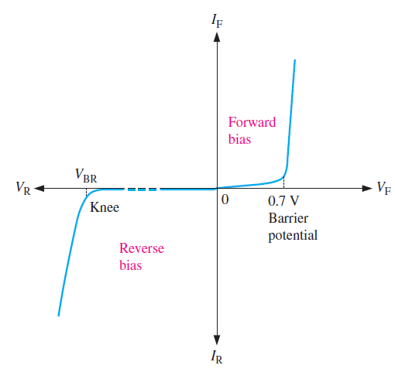
Complete I-V characteristic curve
When a voltage applied across PN junction then the total current I_{D} flowing through the junction is given as:
If V is positive then the PN Junction is FB
If V is negative then the PN Junction is RB

Slide 3
Effect of temperature on reverse saturation current
The higher the junction temperature, the greater the saturation current.
A useful approximation to remember is this: I_{S} doubles for each 10°C rise.
The change in saturation current is 7 percent for each Celsius degree rise.
$$Percentage ΔIs=100\%\text{​ }for {10}^{0} increase of temperature$$
$$Percentage ΔIs=7\%\text{​ }per ^{0}C rise of temperature$$

Slide 4
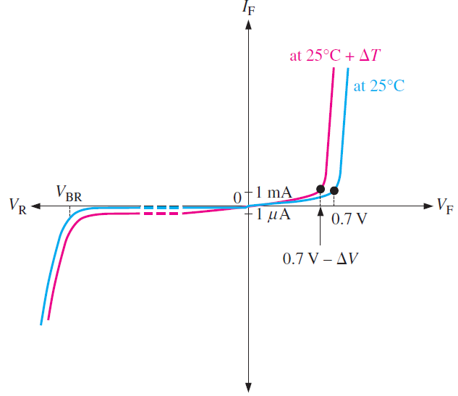
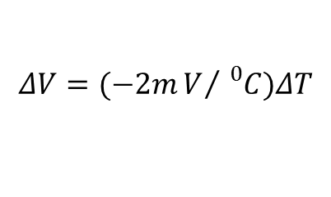
Effect of temperature on barrier potential:
When the diode is conducting, the junction temperature is higher than the ambient temperature because of the heat created by recombination.
An increase in junction temperature, creates more free electrons and holes in the doped regions, it causes narrower of depletion region
Less barrier potential at higher junction temperatures
The barrier potential of a silicon diode decreases by 2 mV for each degree Celsius rise.
$$ΔV=(−2mV/{{}_{}^{0}C})ΔT$$

Slide 5
Effect of temperature on V-I characteristics
The reverse saturation current I_{s} nearly doubles for every 10⁰ C rise in temperature.
When temperature increases by 1⁰ C, the junction voltage drops by -2.5 mV.

Slide 6
Equivalent circuit of diode
Shockley’s equation gives the exponential relationship between current and voltage.
The diode characteristic can be approximated by replacing the
diode in the circuit with its equivalent circuit.
An equivalent circuit is a combination of elements that best represents the actual terminal characteristics of the device.
The diode in the circuit can be replaced by other elements without severely affecting the behavior of circuit.
Equivalent circuit makes the network/complex circuit analysis simpler.

Slide 7
Equivalent circuit of diode
The diode can be modeled in three different ways depending on the accuracy required.
1. Ideal Diode Model
2. Simplified Model
3. Piece-Wise Linear Model

Slide 8
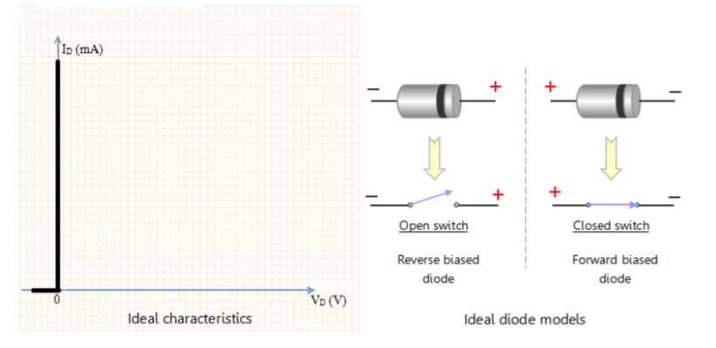
Ideal Diode Model
Ideal diode allows the flow of forward current for any value of forward bias voltage. It can be modeled as closed switch under forward bias condition.
Ideal diode allows zero current to flow under reverse biased condition. It can be modeled as open switch under reverse bias condition.

Slide 9
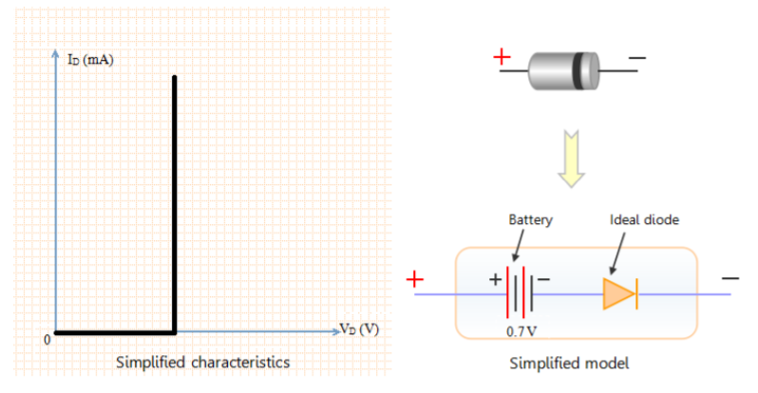
Simplified Model
The equivalent circuit in simplified model consists of a battery and an ideal diode.

Slide 10
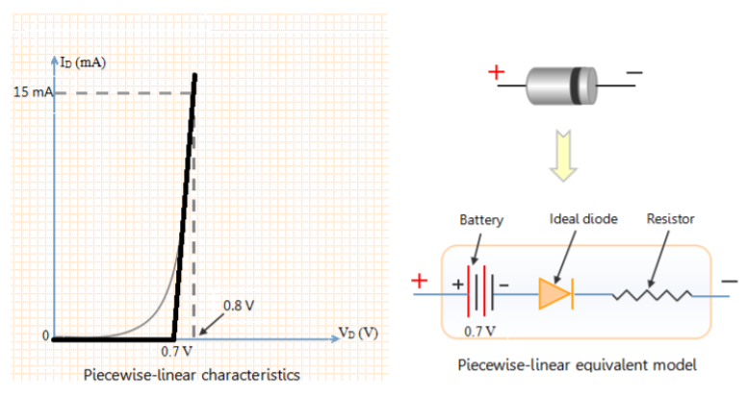
Piece-Wise Linear Model
Piecewise linear characteristics can be obtained by replacing the diode in the circuit with a resistor, a battery and an ideal diode.

Slide 11
Diode resistance
Resistance is the opposition offered to the flow of current through the device.
Diode resistance can be defined as the effective opposition offered by the diode to the flow of current through it.
Diode offers a small resistance when forward biased, which is called as forward resistance.
Diode offers a considerable resistance when it is reverse biased, which is called as reverse resistance.
Diode resistance is classified into two types, static or dynamic depending on whether the current flowing through the device is DC (Direct Current) or AC (Alternating Current), respectively.

Slide 12
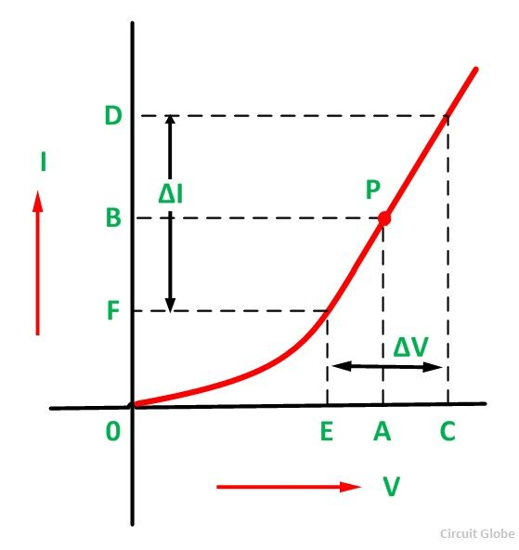
Static Resistance
Static resistance or DC resistance of a PN junction diode defines the diode’s resistive nature when a DC source is connected to it.

Slide 13
Dynamic Resistance
Dynamic resistance is the resistance offered by the diode to the flow of AC current through it when it is connected it in a circuit which has an AC voltage source.

Slide 14
Why Si diode is preferred over Ge diode
Primary reason:
I_{s}(Ge) > I_{s}(Si) :Si diode acts as better switch
PIV(Ge) < PIV(Si) :Si diode gives better operatable range
E_{G}(Ge) < E_{G}(Si) :Si diode gives better thermal range
Secondary reason:
Abundant raw material is available for Si.

Slide 15
The reverse saturation current at 300⁰ K of a PN Junction Ge diode is 5µA. Find the voltage applied across the diode to obtain a forward current of 50 mA.

Slide 16






Q2. Determine the current through a diode at 20⁰ C with a reverse saturation current of 50nA and applied forward bias voltage of 0.6V.
Q1. Current through the diode $I_{d}=I_{s}\left(e^{k{V_{D}}/{T_{K}}}−1\right)$
$$I_{s}=50∗{10}^{−9}A$$
$$T_{k}=273+20={293}^{0}K$$
$$V_{d}=0.6V$$
$$\text{k}=\frac{q}{ηK}=\frac{11600}{η}$$
$η=2$ (ideality factor, it a constant, 2 for Si, 1 for Ge)
$$I_{d}=7.19mA$$

Slide 17







Q2. Assuming a barrier potential of 0.7 V at an ambient temperature of 25°C, what is the barrier potential of a silicon diode when the junction temperature is 100°C? At 0°C?
Q2. When the junction temperature is 100°C, the change in barrier potential is:
$$ΔV=(−2mV/{{}_{}^{0}C})ΔT$$
$$ΔT=({100}^{0}C−{25}^{0}C)={75}^{0}C$$
$$ΔV=−2mV×{75}^{0}C=−150mV$$
Due to change in temp, the barrier potential decreases 0.15V from the voltage at room temperature
When the junction temperature is 100°C, the change in barrier potential is:
$$V_{b}=0.7−0.15=0.65V$$
$$ΔT=(0^{0}C−{25}^{0}C)={−25}^{0}C$$
$$ΔV=−2mV×{−25}^{0}C=50mV$$
$$V_{b}=0.7+0.05=0.75V$$

